Slide 1
The year in .NET Security
2 Secure
2 Curmudgeonly
Barry Dorrans
.NET Security, Microsoft

Slide 2
Vulnerability vocabulary
1

Slide 3
CVE
Common Vulnerabilities and Exposures
A uniform standard for identifying and reporting security vulnerabilities.
https://www.cve.org/

Slide 4
CVSS
Common Vulnerability Scoring System
CVSS is not a measure of risk.
v3 score calculated from exploitability and impact metrics.
As a framework we score based on the worst possible scenario.
https://nvd.nist.gov/vul-metrics/cvss

Slide 5
CWE
Common Weakness Enumeration
A list of common software and hardware weaknesses.
Community maintained.
CWEs are usually introduced by developers, or LLMs.
https://cwe.mitre.org/

Slide 6
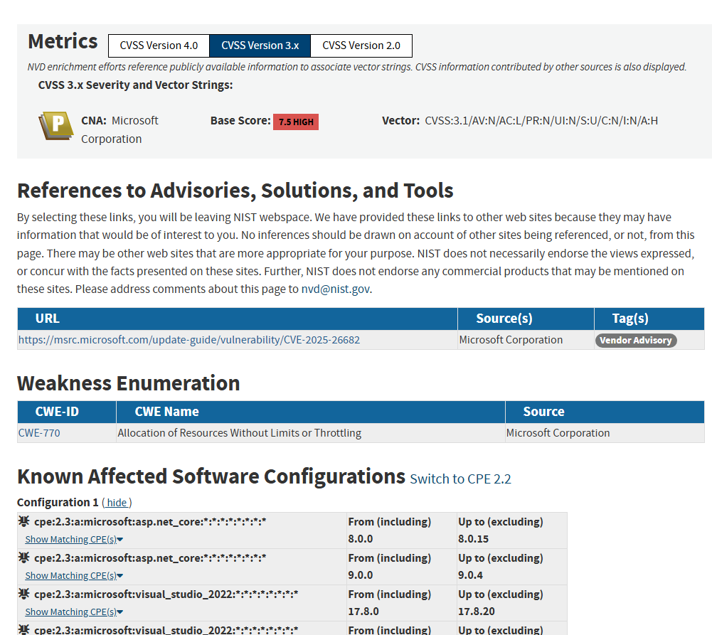
For example,
CVE-2025-26682
https://nvd.nist.gov/vuln/detail/CVE-2025-26682

Slide 7
This year in vulnerabilities
2

Slide 8
Reports and CVEs
2026: 2622
2026: 97
2025: 84
2025: 12
MSRC Cases
CVEs

Slide 9
Bounty awarded
Not all valid MSRC reports get CVEs.
We issue for medium CVSS and above.
Bounties get paid things that don’t need a CVE, e.g. docs.
There are more security fixes made behind the scenes.
2026 $1,012,500
2025 $635,500
Bounties

Slide 10
Vulnerabilities by Type

Slide 11
CVSS Severity

Slide 12
Key .NET Vulnerabilities
3

Slide 13
The fix author may not have written the vulnerable code

Slide 14
Out of band patches
3.1

Slide 15
CVE-2026-11497 – Brotli RCE
Compression
An out of bounds write in Google’s Brotli library allowed remote code execution in NPM.
We don’t believe you could have gotten there in .NET, but we stuck with RCE as that’s what Google classified it as.
HttpClient you have to opt-into response decompression.
ASP.NET you had to opt-into Brotli request decompression.
Take away
Keep an eye on your dependencies, sometimes the formal CVE process doesn’t work or isn’t followed.

Slide 16
CVE-2026-105016 – MSQuic RCE
Networking
Highest scoring vulnerability this year at 9.8
But … not so much for .NET
  MSQuic is run inside the Windows Kernel, thus 9.8
  .NET runs it in process, maybe 9.2, 9.0?
Takeaways :
CVSS scores are not a good metric for severity
I try to do a breakdown on Bluesky of the month’s CVEs (@blowdart.me) which may help you prioritise.

Slide 17
Denial of Service
3.2

Slide 18
CVE-2026-32203
System.Security.Cryptography.Xml DoS
The method EncryptedXml.DecryptEncryptedKey() iterates through the KeyInfo clauses of the provided key. When it encounters a KeyInfoEncryptedKey clause, it recursively calls DecryptEncryptedKey` on the inner key. This recursive call path does not increment or check the _xmlDsigSearchDepthCountergiving unbounded recursion, leading to a StackOverflowException which terminates the host process.
Take away
When you add a guard make sure it applies everywhere.

Slide 19
CVE-2026-84008
System.Security.Cryptography.Pkcs DoS
The built-in CMS verifier reconstructs the entire embedded certificate set once per signer - no trust required. A 108 KB message stalls a real service for seconds. SignedCms - the in-box CMS/PKCS#7 verifier - reconstructs and reparses all embedded certificates every time it resolves a signer's certificate, and it does that once per signer.
Take aways
Billion laughs attacks are everywhere. A 117kb message caused 160,000 certificate constructions. Fix was to parse a certificate once. Check your algorithm complexity.

Slide 20
CVE-2026-57108
.NET Runtime DoS
When the attacker presents a self-issued certificate whose SAN extension carries the 21-byte payload from the report, the service identity-mapping code calls cert.GetNameInfo(), which dispatches to the OpenSSL PAL and crashes the worker process before the certificate chain trust is ever evaluated. This can be repeated for a persistent DOS.
Take aways
DoS is not just resource consumption
You cannot know if unmanaged APIs validate their inputs. Assume not and validate before passing.

Slide 21
Remote Code Execution
3.3

Slide 22
Remote Code Execution Vulnerabilities
Common in
  Desktop runtime (WPF/XPS)
  MS DIA
  .NET SDK

Slide 23
CVE-2026-50646
System.Windows.Controls RCE
When an XPS-created Frame navigates to child XAML content through the async path, nested Frame elements are created without the IsUnsafe marking. These nested frames then navigate to further attacker-controlled XAML parts without restrictive parsing, allowing instantiation of ObjectDataProvider to execute Process.Start("calc.exe").
Take aways
XPS is quite undocumented. Like PDF it can include code. Edge cases are everywhere. Document your formats and fuzz them with purpose, not random data.

Slide 24
CVE-2026-96237
.NET SDK RCE
Workload integrity repair in Microsoft .NET SDK 10.0.400 does not enable NuGet Package Source Mapping, even though normal workload install paths enable and enforce it.
An operator of a configured NuGet source that the victim maps only to `Contoso.*` can therefore supply a Microsoft-named missing workload SDK pack.
Take aways
When you add security enforcement for a feature, check if applies to other features and enforce it there as well.

Slide 25
Information Disclosure
3.4

Slide 26
CVE-2026-66822
.NET Information Disclosure in SocketsHttpHandler
When an HTTP proxy returns 407 Proxy Authentication Required, .net derives a Basic authentication token and assigns it to ProxyAuthorization header.
If the HTTP origin then returns a redirect to HTTPS, RedirectHandler removes Authorization but does not remove Proxy-Authorization. It changes the URI on the same request object and resends it.
Take aways
We thought long and hard about HTTPS redirecting to HTTP, but not the other way around. Cover all flows.

Slide 27
Key ASP.NET Vulnerabilities
4

Slide 28
CVE-202-11497 – Brotli RCE
Compression
An out of bounds write in Google’s Brotli library allowed remote code execution in NPM.
We don’t believe you could have gotten there in .NET, but we stuck with RCE as that’s what Google classified it as.
HttpClient you have to opt-into response decompression.
ASP.NET you had to opt-into Brotli request decompression.
Take away
Keep an eye on your dependencies, sometimes the formal CVE process doesn’t work or isn’t followed.

Slide 29
CVE-2026-40372 –Security Bypass
ASP.NET Core Identity
Another OOB patch, this time in April 2026.
Bug in ASP.NET data protection, where you could append an all-zero MAC (message authentication code) and the payload would validate.
Why? ComputeHash() allocates and returns a new byte[], it does not write into any existing span. The correctHash span therefore remained all zeros from the stackalloc, passing the check.
Take aways
Spans are sometimes hard to use correctly.

Slide 30
CVE-2026-70188 – Security Bypass
HPACK poisoning
Kestrel HTTP/2 request trailers and dynamic HPACK values may accept newline characters instead of rejecting malformed input.
Thus, one request is treated as two requests & auth bypass.
Take aways
The old adage of “be strict in your output, forgiving in your input” is a giant pit of security failure.
Canonicalisation is hard.
You don’t have to support every part of an RFC.

Slide 31
CVE-2026-47300 – ASP.NET EoP
Auth & LDAP Lookups
Once again, like last year, the continued “Windows Auth on Linux” is a pit of fail.
We made bad promises based on a customer requests.
Linux is not Windows. It can’t be made to behave like Windows. Windows auth is for Windows hosts.
Move to OAuth already
Take away
Sometimes promising a customer a feature for ease of use is going to be an ongoing security problem.

Slide 32
Aspire Vulnerabilities
5

Slide 33
Aspire
They’re not .NET but their security is still mine
CVE-2026-120006 – RCE from a cookie replay bypassing authentication
CVE-2026-120778 – RCE from file planting a Directory.Build.rsp
CVE-2026-120792 – Information disclosure via a symlink race in /tmp on Linux
CVE-2026-118740 – Security feature bypass in the dashboard exposed the browser token and allows telemetry delete.
Take aways
The Aspire dev manager told me two months how pleased they were that aspire had no CVEs …

Slide 34
In conclusion
6

Slide 35
What we’re thinking about
More details in CVEs
CVE-2026-47300: “An elevation of privilege vulnerability exists in the ASP.NET Core Negotiate authentication handler in .NET 8, .NET 9, and .NET 10 due to improper validation.”
CVE-2026-47300: “The root cause is the use of non-authoritative CN strings for domain-wide LDAP searches, leading to elevation of privilege through two primitives: within-realm CN rebinding and cross-realm `@`-strip. Exploitation allows unauthorized role claims”

Slide 36
Reporting vulnerabilities
Help me pay you!
Vulnerabilities & Security bugs go to MSRC, not in GitHub issues. https://msrc.microsoft.com/report/vulnerability
If you do use AI to find things, please check your results.
We have grounding docs for your AI agents, use them
https://aka.ms/dotnet/securityfoundations
I may have to write you a cheque.
https://aka.ms/dotnet/bounty

Slide 37
Thank you
Next year
Curmudgeonly and Furious,
Redmond 25mph Prius?

